Slide 1
ACADEMIC PROJECT DEFENSE • M.SC. (IT) SEM III • 2026–2027
NetSentinel AI Intrusion Detection
Next-generation threat telemetry, 41-feature multi-class attack classification, and automated SOC operations.
PROJECT AUTHORS
SUPERVISION & INSTITUTION
Priyansh Nagar (2505102140025) • Rohit Majhi (2505102140028) • Saksham Pandey (2505102140046)
Guide: Dr. Chetan Gondaliya • Parul University

Slide 2
01 / PROBLEM STATEMENT & CONTEXT
Why Legacy IDS Solutions Fail
Traditional Signature IDS
The NetSentinel AI Solution
Zero-Day Blindness: Misses novel payloads lacking static rules.
Behavioral ML: Inspects 41 statistical network flow features.
SOC Alert Fatigue: Exceeds 4,000 daily false-positive alarms.
High Precision: 97.93% precision suppresses false alarms.
Signature Latency: Averages 72 hours for rule updates.
Sub-2ms Inference: Real-time classification on live streams.
Fragmented Tooling: Raw PCAP CLI lacks incident triage.
Unified SOC Platform: Role-isolated triage and resolution.

Slide 3



02 / PROJECT OBJECTIVES
Core System Capabilities
Live Packet Sniffing
Multi-Class ML Engine
Batch CSV Scoring
Async Retraining
Continuous TShark interface packet capture.
Bulk NSL-KDD dataset evaluation export.
Zero-downtime background weight updates.
Six-category behavioral threat classification.

Slide 4
03 / SYSTEM ARCHITECTURE
Four-Tier Modular Architecture
TIER 01
TIER 02
TIER 03
TIER 04
Presentation UI
Django & RBAC
ML Inference
Data & Capture
Chart.js live telemetry views.
RoleAccessMiddleware tenant isolation.
Random Forest 41-feature scoring.
SQLite3 DB and TShark sniffer.
Asynchronous background threads isolate model retraining from HTTP worker processes.

Slide 5
04 / DATA FLOW DECOMPOSITION
DFD Level 1 Core Subprocesses
ID | Subprocess Name | Primary Input | Output / Data Store
P1 | Authentication & RBAC | User credentials | DS-1 User Profiles
P2 | Live Packet Capture | TShark / Synthetic RNG | Raw packet flows to P4
P3 | Batch CSV Ingestion | Uploaded CSV dataset | Validated vectors to P4
P4 | ML Feature Inference | 41-dim feature vector | Class & confidence (DS-5)
P5 | Alert & Log Persistence | Classified threat records | DS-2 Logs & DS-3 Alerts
P6 | Model Retraining Worker | Historical logs (DS-2) | Updated weights (DS-5)
P7 | Telemetry & Reporting | Aggregated querysets | SOC charts & scored CSV

Slide 6
05 / MACHINE LEARNING PIPELINE
41-Feature Random Forest Pipeline
Why Random Forest Over Deep Nets?
41
Tabular Excellence: Superior accuracy on mixed discrete features.
NSL-KDD Flow Attributes
Colinearity Resistance: Bagging prevents variance overfitting.
1–9 Basic: Protocol, service, flag, byte counts.
10–22 Content: Failed logins, root shell, su flags.
Gini Interpretability: Exports transparent JSON feature weights.
23–31 Time Window: 2-second SYN and REJ error rates.
32–41 Host Window: 100-connection destination ratios.
CPU Efficiency: Sub-2ms execution without GPU hardware.

Slide 7
06 / THREAT TAXONOMY
Six-Class Intrusion Taxonomy
Category | Real-World Attack Examples | Key Behavioral Indicator | Severity
Normal | Web browsing, SSH, DNS queries | High same_srv_rate, SF flag | INFO
DoS / DDoS | SYN Flood, Smurf, Neptune | High serror_rate, zero dst_bytes | CRITICAL
Probe | Nmap Port Scan, IP Sweep, Satan | Multi-port connections, high rerror_rate | HIGH
R2L | FTP dictionary, password guessing | Repeated num_failed_logins | HIGH
U2R | Buffer overflow, rootkit execution | Elevated root_shell, su_attempted | CRITICAL
Brute Force | Automated SSH / HTTP hammering | High-velocity single-IP login bursts | MEDIUM / HIGH

Slide 8
07 / RELATIONAL DATABASE SCHEMA
SQLite ORM Schema & Data Isolation
15-table relational catalog enforcing strict multi-tenant RBAC and historical audit preservation.
ids_alert
Incident severity resolution tracking.
ids_trafficlog
ids_predictionrun
ids_modelmetrics
ids_userprofile
High-frequency flow audit storage.
Batch JSON Gini importance logs.
Immutable retraining accuracy audit.
Strict analyst role access isolation.

Slide 9
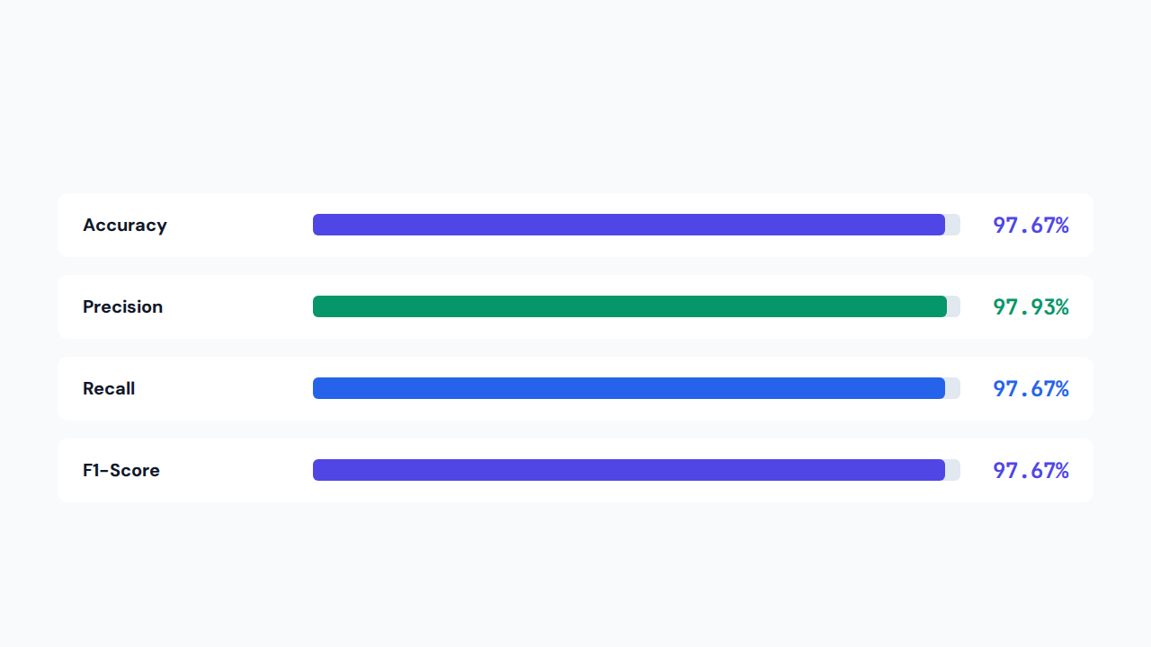
08 / EXPERIMENTAL BENCHMARKS
Benchmark Metrics & Test Verification
VERIFICATION: 10/10 Automated Suite Passed (TC-01 to TC-10) • Latency < 2.0 ms per flow

Slide 10
09 / CONCLUSION & FUTURE ROADMAP
Future Roadmap & Open Q&A
Upcoming milestones include Bi-LSTM sequence modeling, Splunk/Sentinel SIEM connectors, SHAP explainability, and distributed multi-cloud VPC sensor probes.
97.67%
< 2.0 ms
10 / 10
Classification Accuracy
Inline Inference Latency
Automated Tests Passed
Thank You • Priyansh Nagar, Rohit Majhi, Saksham Pandey • Guided by Dr. Chetan Gondaliya

